Slide 1



Visual Studio Code
Fredrik Wall fredrik@poweradmin.se

Slide 2
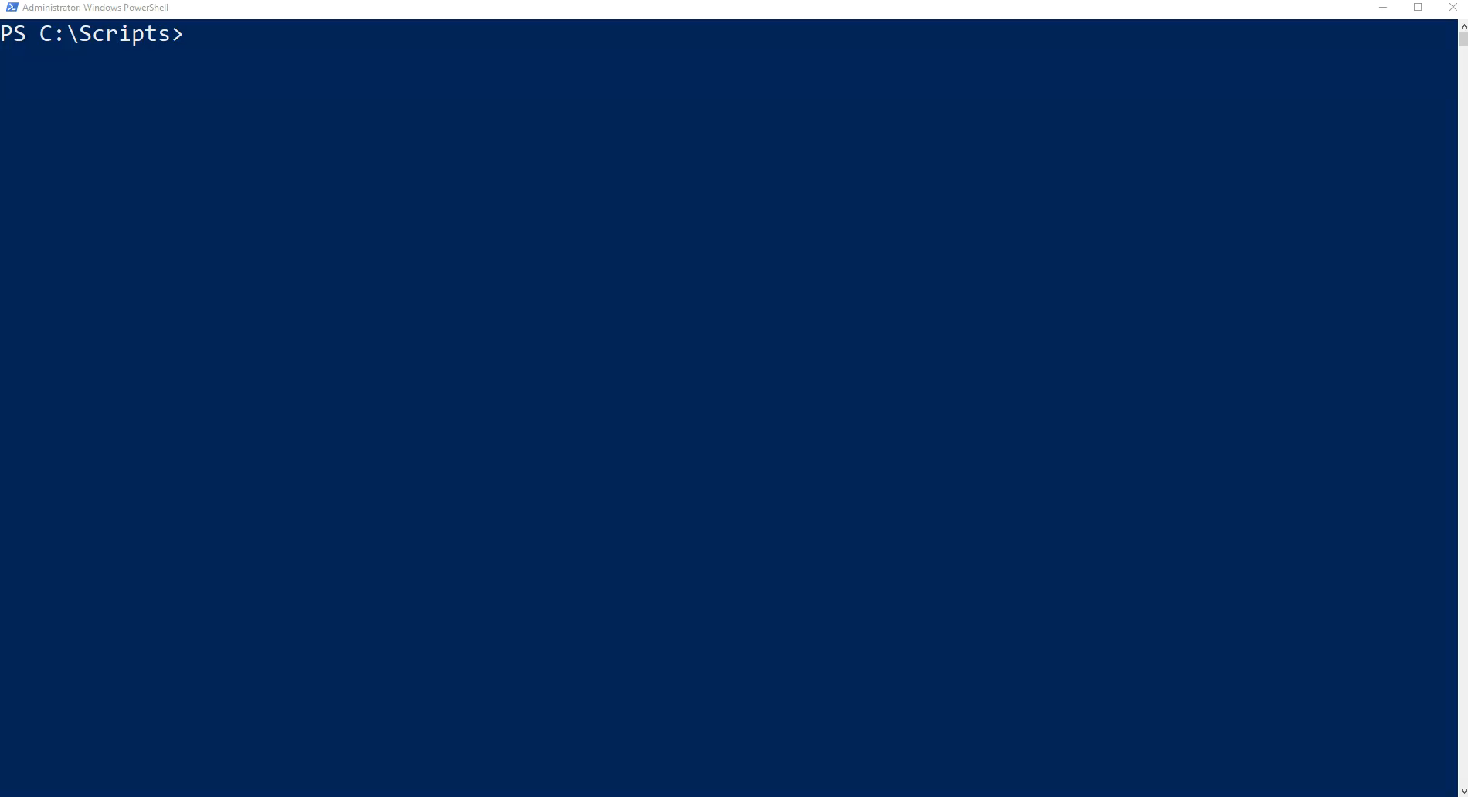

About me
Notes:
Fredrik Wall
Senior IT Consultant/Trainer/Speaker/Scripting Geek
Stockholm / Sweden
PowerShell for more then 13 years
Co-founder / Co-leader of PowerShell User Group Sweden

Slide 3
Introduction to this video
What is Visual Studio Code?
Download and Install
Themes
Extensions
PowerShell and Visual Studio Code
Snippets
Tweak like PowerShell ISE
Uninstall and Install VSCode automatically

Slide 4
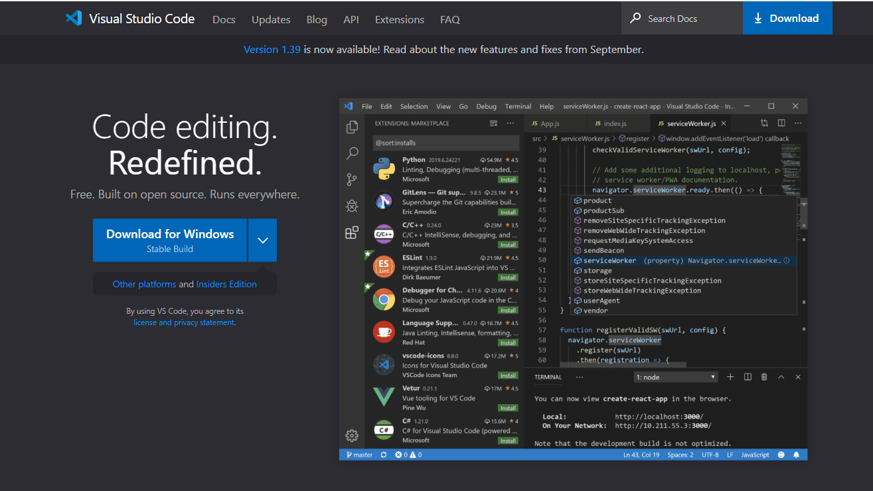
What is Visual Studio Code?
Source code editor
The replacement for PowerShell ISE
Free
For Windows, macOS och Linux
InteliSense
Debugging
Built-in Git
Extensions
Lots of settings to make it as you want
Notes:
Source code editor – like PowerShell ISE
Microsoft have stopped developed PowerShell ISE and Visual Studio Code is the replacement editor with the PowerShell extension
Free
For Windows, macOS och Linux
InteliSense – code completion, parameter information, quick information and member lists
Debugging - Node.js runtime and can debug JavaScript, TypeScript, or any other language that gets transpiled to JavaScript. More with extensions
Built-in support for Git – Versionhandling
Extension – To extend Visual Studio Code

Slide 5

Download and Install
Windows, macOS, Linux
Two versions
Stable (Updates 1/Month)
Insiders (Updates 1/day)

Slide 6
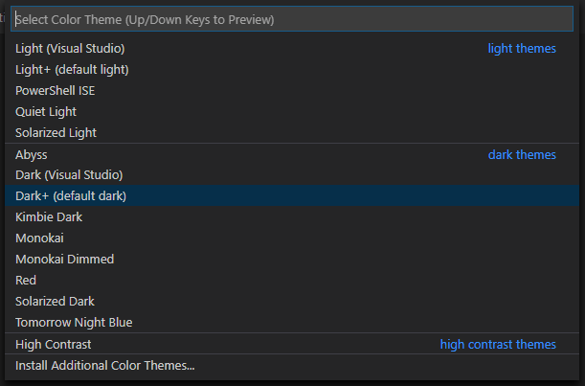
Themes
PowerShell ISE theme
Color themes
File icon themes
Can create own themes

Slide 7
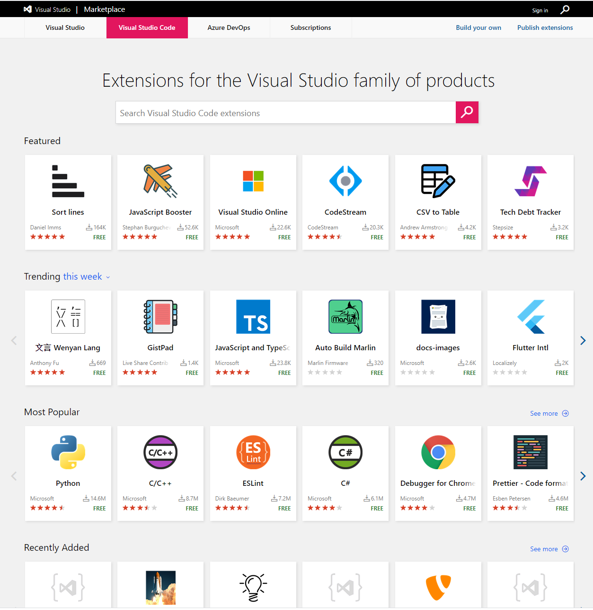
Extensions
More functionality
Support for more file formats
Help to format code
BuiltIn extensions
PowerShell
Settings Sync
XML
VBScript
Marketplace in VSCode
marketplace.visualstudio.com/VSCode
Install extensions offline

Slide 8
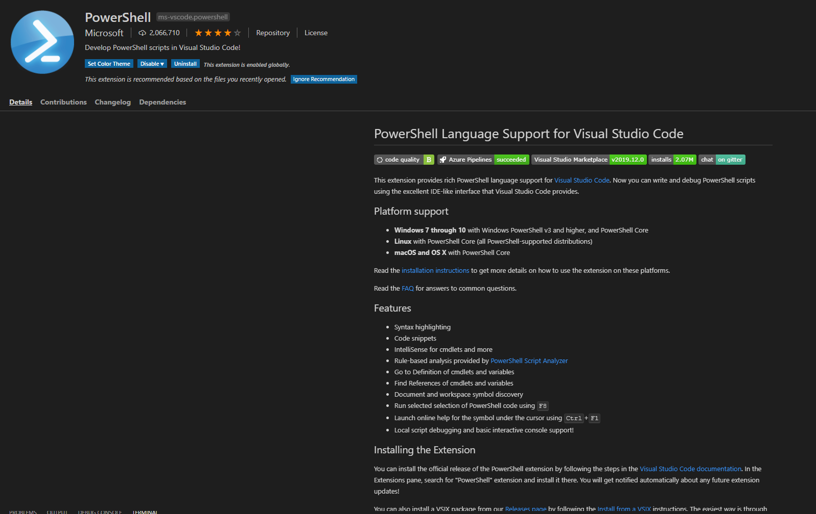
PowerShell and VSCode
Install PowerShell extension
Set PowerShell as Default file format
Syntax highlightning
Code snippets
InteliSense
Rule-based analysis of the code
Format code
Run selected code

Slide 9
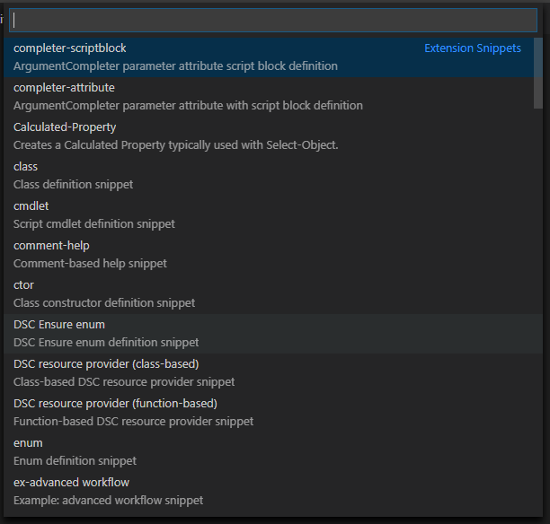
Snippets
What is snippets?
Lots of snippets with the PowerShell extension
Add your own

Slide 10
Tweak like PowerShell ISE
Zoom/Change font size with Mouse Wheel
Tab completion
Set PowerShell as default language
Change font size on terminal window
Don’t focus on terminal window when run

Slide 11
Uninstall and Install VSCode Automatically
Uninstall script to completly uninstall VSCode with extensions and everything
Install with the PowerShell teams Install-VSCode.ps1 script

Slide 12
Thanks for watching
www.fredrikwall.se
www.retune.se
www.cornerstone.se

